Slide 1
Progress Report Crime Modeling
John Morgan, Marcus Maravilla,
jobe Goetz, Harvansh Pelia

Slide 2
Final Project – Predictive Crime Modeling
Abstract:
Gather Data about Time, Date, Demographic, and Crime Type from Dense Cities (New York, Chicago, LA...)
Create and Train a model to perform crime predictions and test those predictions with actual crime rates.
Finally create a presentation to show our findings and discuss the process of gathering data and the algorithms used.

Slide 3

Crime Modeling New York City
We concluded on making our model based off the crime in New York City
To find the data on crime rates in New York City...
We researched multiple websites online that had Open Data Crime Rates
We found a website called NYC Open Data that had open data of New York City's crimes
The data goes from 10/28/2016 - 2/6/2025

Slide 4
Gathering Data
From the data that we found, there is around 4600 crimes in the spreadsheet
This is more than enough for out crime modeling predictor
The data was given by the New York Police Department
The data is updated quarterly
Along with the data came a footnote with explanations of certain words

Slide 5
Example of Data
Data is divided up into different sections:
NYPD complaints (criminal complaint reports filed in NYC by the NYPD)
NYPD arrests (physical arrests made by the NYPD)
NYPD shooting incidents
Vehicle stop reports (traffic stops)
Criminal court summons (summons issued by NYPD)

Slide 6
Which of these are we using?
For this project we decided to look at the NYPD arrests dataset provided by NYC OpenData
We can filter by arrest type, date, and each arrest even has its own unique key if you want to track a specific one
This dataset also provides sex, gender, age group, and exact coordinates as to where the arrest took place

Slide 7
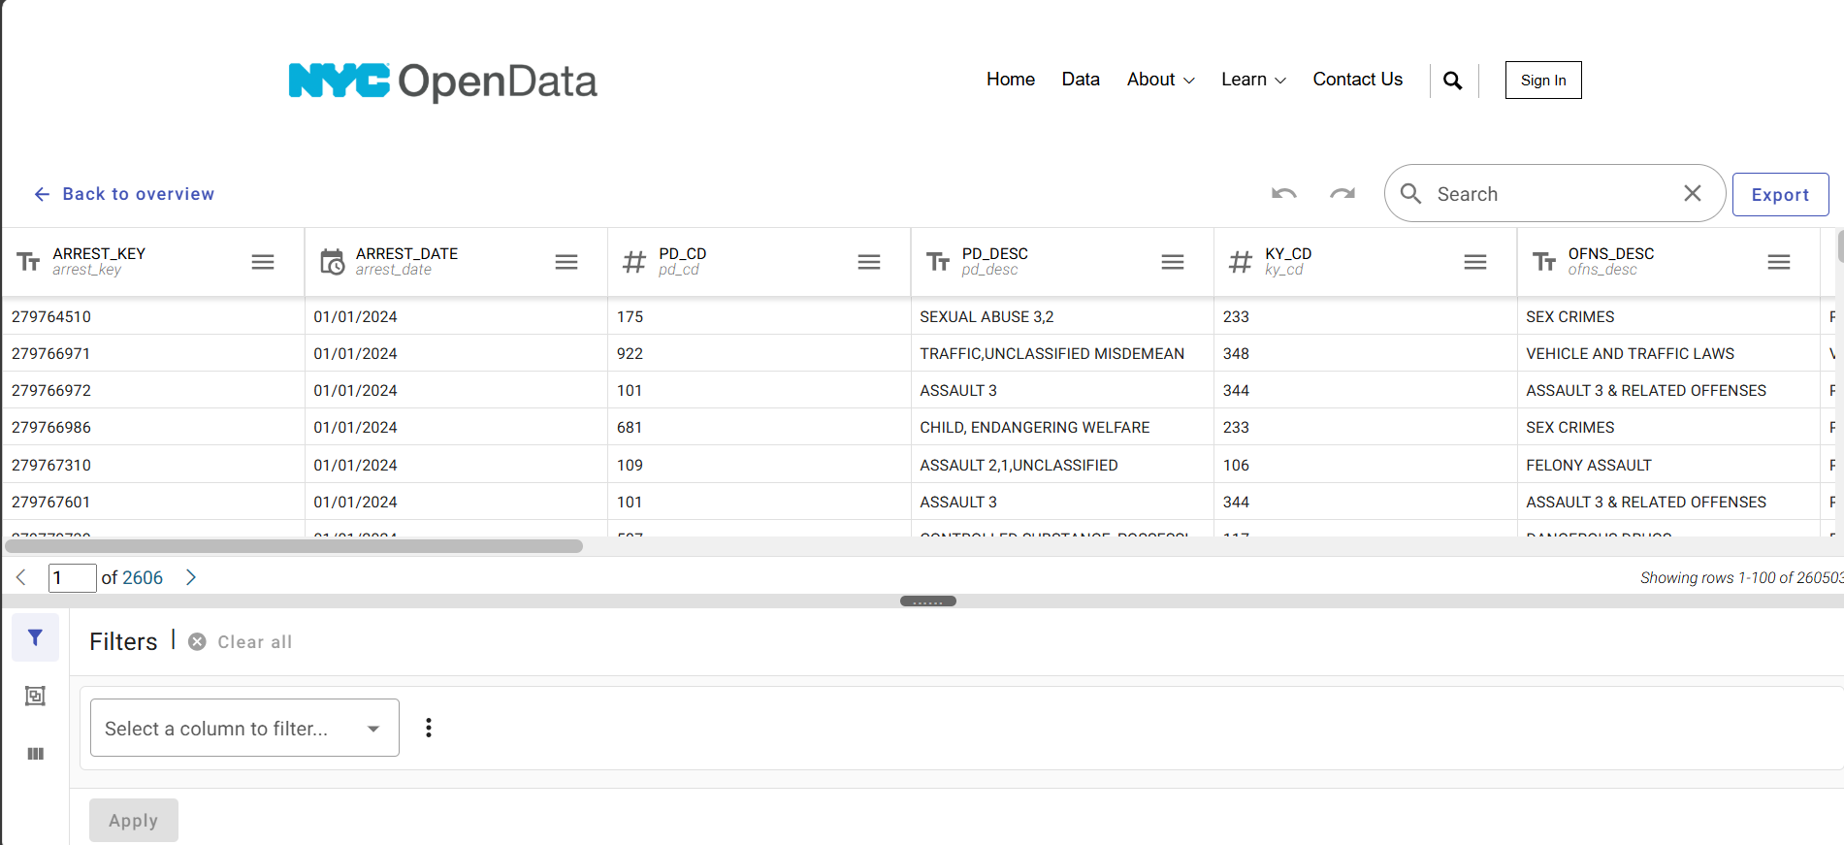

Slide 8
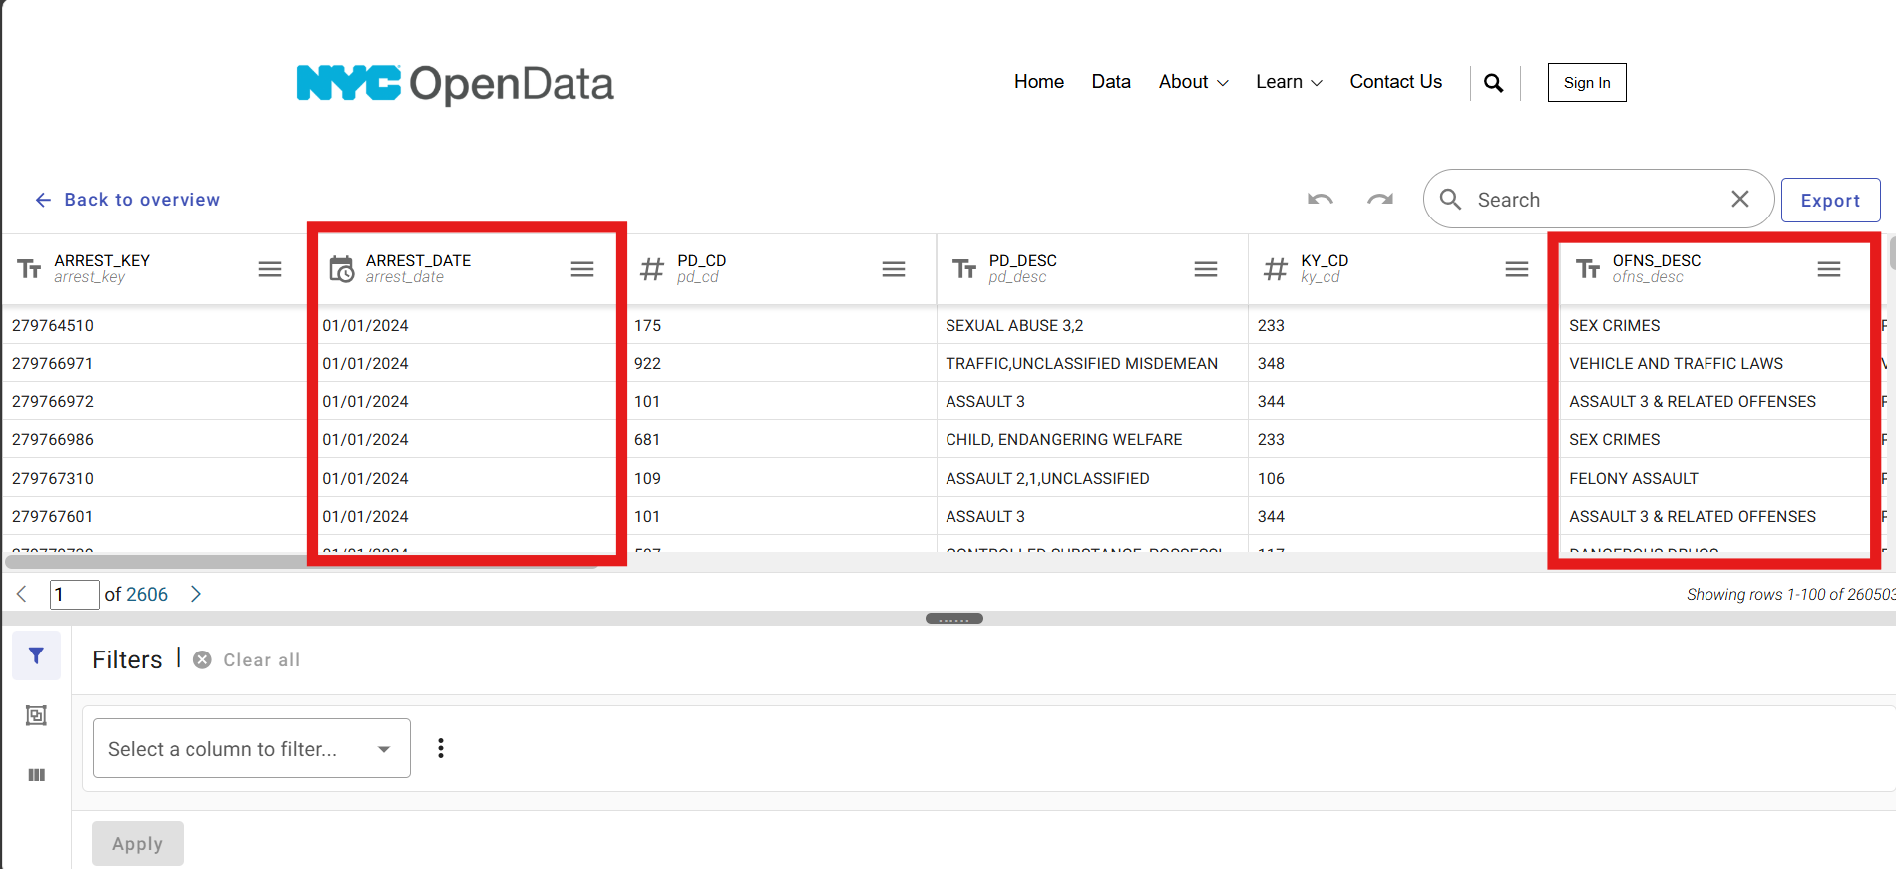

Slide 9
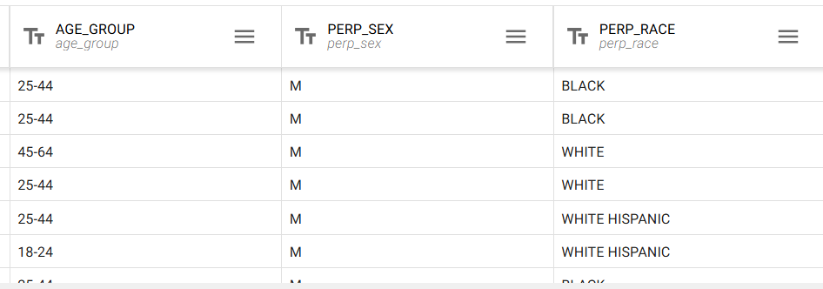
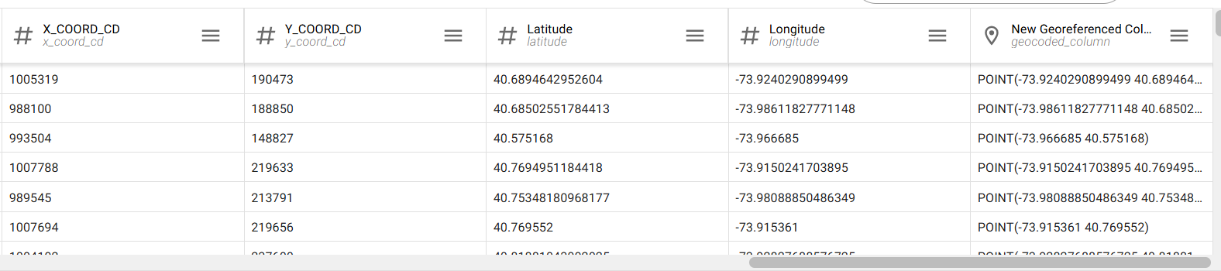

Slide 10
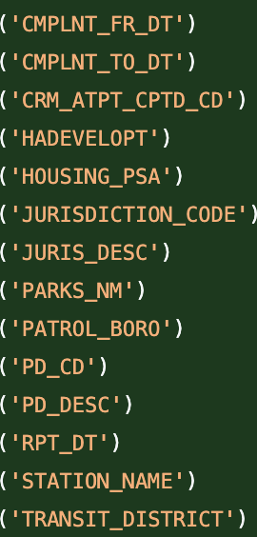
Model Progress
Data Preprocessing
Using scikit-learn as machine learning library
Load data
- Exported as CSV from NYC Open Data
2. Clean data using pandas
- Remove missing and unnecessary values

Slide 11
Model Next Steps
Feature Engineering - Make patterns clearer for model
2. Choose classification model
- Random Forest, Logistic Regression
3. Train model
4. Evaluate model
Notes:
Random Forest – multi-class classification for example predicting different crime types For example, we would need to create a "Crime Zone" feature - Using existing data (latitude, longitude), use k-means clustering

